Slide 1
Stand-Scale Forest Models in B.C.:
Which one works for you?
Erin Hall RPF, MSc
Northern Silviculture Committee Winter Workshop 2026
Feb 18, 2026

Slide 2
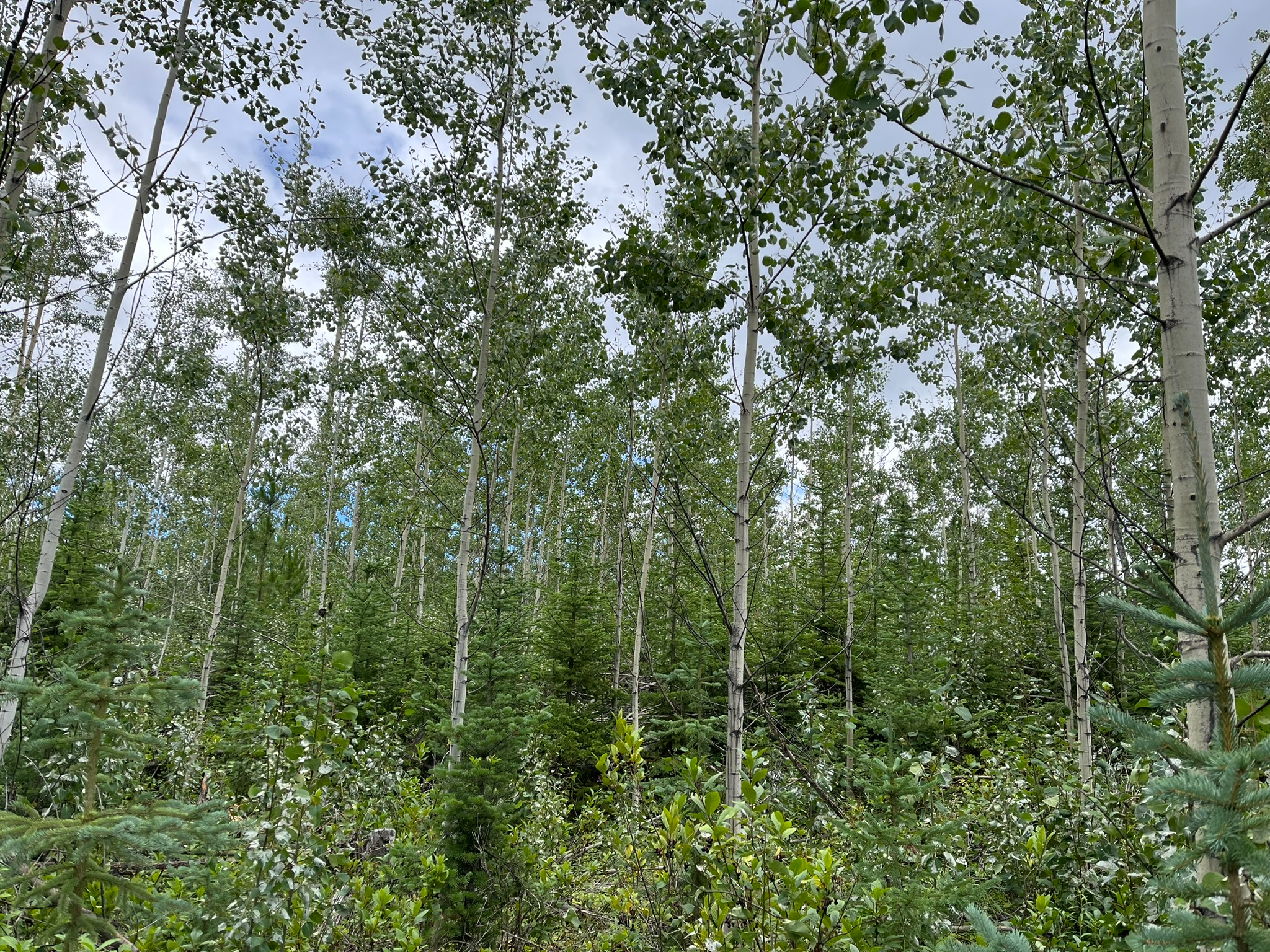
Notes:
Young sx / At mixedwood
Spruce decent leader length but growing under fairly large aspen
20, 40, 80
Spruce remain in the understory of maturing aspen?
Or grow through the Sx?
How would the yield of spruce in this stand differ if the aspen hadn’t been spaced? Or if all the aspen was entirely removed?
These are questions that Models can help us address

Slide 3
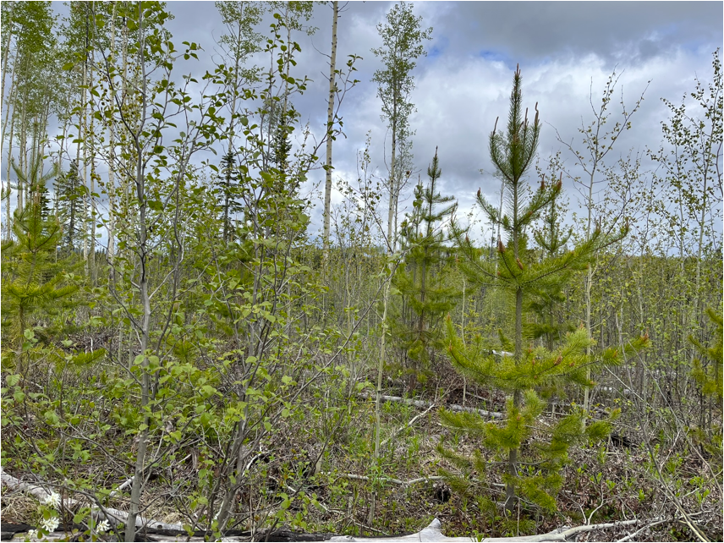
Notes:
A model could also be used to explore what the outcome might be for an aspen – pine - mixedwood

Slide 4
Outline
Overview of forest modelling
Introduce forest models in BC
Model selection criteria – which one is right for you?
Notes:
Which model or models are right for you
- And in which scenarios

Slide 5

What Are Forest Models?
Simplified representations of reality
  Explore how forests grow, change and respond to disturbances
Not crystal balls
  Don’t predict the future
    Explore possible futures based on assumptions
Notes:
models are simplified, not perfect, representations of reality.
Types of models:
simple toy models that illustrate concepts,
My playmobil forest : r/Playmobil
mental models that represent our internal understanding of systems,
Mental Models; A Guide to how your Users Really Think | by Faith Olohijere | UX Planet
mathematical models - equations to describe relationships between variables,
Photosynthesis equation with molecular models. Biochemical process used by plants responsible for producing the oxygen O2. Sugars are synthesized from carbon dioxide CO2, and water H2O. Stock-vektor | Adobe Stock
simulation models that predict results under different scenarios
Forest Vegetation Simulator - ESSA
optimization models that identify the best solution from a set of possible options.

Slide 6
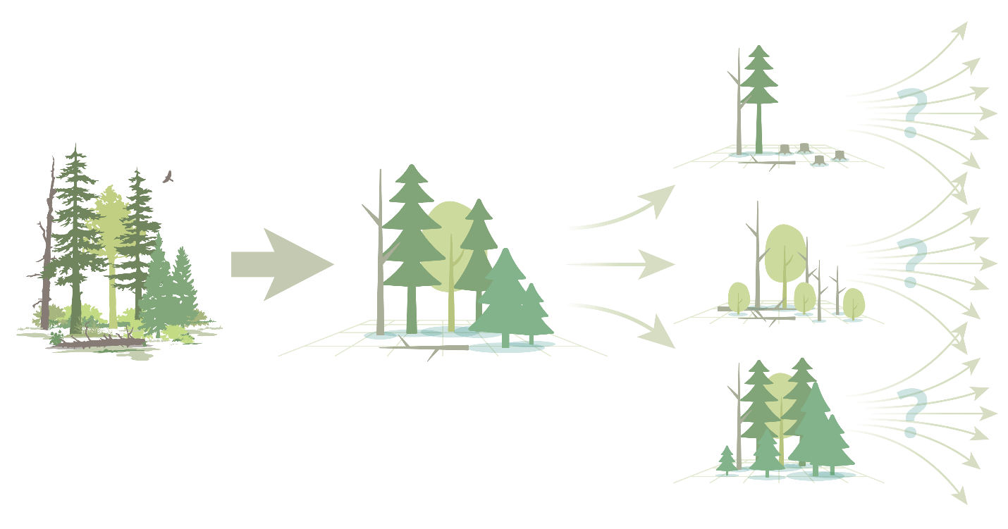
Why Use Forest Models?
Forests are complex, diverse, and constantly changing
Field experiments alone cannot answer all management questions
Models allow
  test scenarios
  evaluate long‑term outcomes
Support informed decision‑making
Notes:
B.C.’s forests are ecologically rich and dynamic, making them challenging to predict outcomes of management actions or disturbance events.
ALLOW:
They allow managers to explore “what‑if” scenarios that would be impossible to test fully in real forests.
SUPPORT:
While models don’t provide absolute answers, they do provide clarity on anticipated responses of a forest to different changes

Slide 7



What Models Help Us Do
Test management options
  Evaluate harvest patterns and silviculture treatments
Understand stand and landscape dynamics
  Interactions among species, disturbances,
  environmental conditions
Forecast growth, yield, and timber value
Support assessments of carbon and habitat dynamics

Slide 8



Stand‑Scale Models
Focus on individual stands
  Simulate growth, competition and mortality dynamics
May be individual‑tree or whole‑stand
Useful for silviculture and stand‑level decisions
Notes:
Two scales of Models used in B.C.
Stand‑scale models simulate growth, competition and mortality dynamics within a single stand,
-
- often an area smaller than a typical harvest block

Slide 9
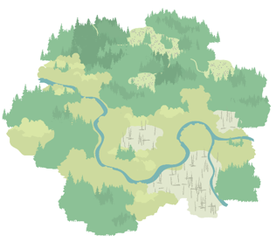

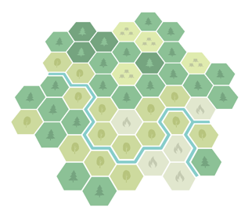
Landscape‑Scale Models
Cover large areas with many stands
Include disturbance regimes, land‑use changes, and long‑term planning
Examples: FSSIM, Patchworks, LANDIS-II
Potential Applications:
  How would fires and pest outbreaks influence future timber supply?
  What are the effects of climate change on forests?
    wildfire and forest health dynamics
Poll
Notes:
landscape‑scale models integrate many stands and disturbances across broader regions.
Both scales are essential for forest planning.
Poll: How many people have worked with a landscape scale model?
- and I’m curious - Which one?

Slide 10
Limitations of Models
Simplified representation of complex systems
Quality of outputs reflect the quality and resolution of input data
Need users familiar with the ecosystem and the model
  Effectively interpret results
Involve trade‑offs between complexity and usability
Require transparency in assumptions, data sources, and validation
Notes:
Powerful tools! - models are not perfect representations of reality.
Poor inputs lead to poor outputs,
users must understand both the model and the ecosystem in order to effectively interpret results
Complexity and usability – the more complex the model, the greater degree of understanding to interpret results.
When Using models – it is important to be Transparent in assumptions, data sources, and validation to build trust in the results.
- Validation – test of accuracy of the model against real world data

Slide 11
Stand‑Scale Models
Inputs:
  Tree composition – species, size, density
  Silviculture treatments and/or disturbance events
Model ecological processes:
  Rates of tree growth, tree mortality, competition between trees
Outputs:
  Stand growth over time
  Change in species composition
  Growth and yield tables
Notes:
Stand‑scale models simulate growth and dynamics within a single stand, (often an area smaller than a typical harvest block)
Vast array of outputs – depends on the model and the output that you are interested in

Slide 12
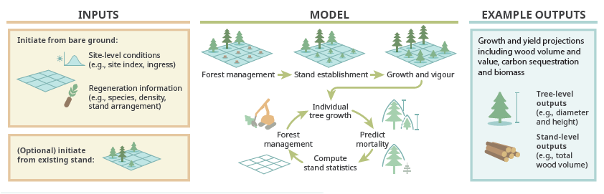
Notes:
This diagram is an example of the infographics in the model report for TASS
provides a visual for the typical flow of processes in a stand scale model
For each time - 1st define harvest intervention and then
Tree establishment
Projects individ tree growth
Predicts mortality
Compute stand statistics
Occurs iteratively over the time scale of the model run

Slide 13
Quiz Time!
Notes:
Identify the 6 Stand-scale models adapted for use in B.C.
Moderator – let us know when someone online adds a model to the list

Slide 14
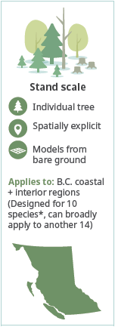
TASS - Tree and Stand Simulator
Regional Applicability: Forests of B.C.
  Designed for Fdc, Fdi, Cw, Hw, Ss, Dr, Sx, At, Pl + additional sp.
Function:
  Provincially developed and supported model for growth and yield
  Individual tree growth & yield model
  Models thinning, partial harvests, wood quality, fertilization, forest health
  TASS II: even-aged, single species
  TASS III: pine/spruce mixedwoods, multi cohort
  *Calibrated for Fdc, Fdi, Cw, Hw, Ss, Dr, Sx, At, Pl, Pl/Sx
Notes:
TASS has been used for over 45 years in B.C.
The Tree and Stand Simulator (TASS) models the growth of individual tree crowns based on their spatial relationships with other tree crowns.
…
- TASS III adds multi‑species realism and light‑based competition.
TASS is powerful but complex.
Its detailed crown modelling makes it valuable for understanding stand structure and light competition,
but its usability is limited by documentation and training availability.
Detailed report released last week for TASS III ???
Strengths / Applications :
Realistic crown modelling
Supports many treatments
Includes wood quality & carbon
Limitations:
Limited documentation
Few trained users
TASS II restricted to single species

Slide 15
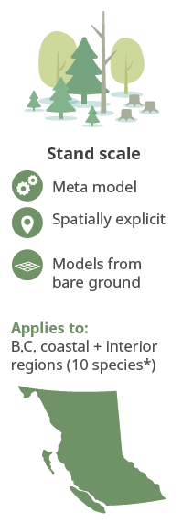
TIPSY - Table Interpolation Program for Stand Yields
Regional Applicability: Forests of B.C.
  Designed for Fdc, Fdi, Cw, Hw, Ss, Dr, Sx, At, Pl + additional sp.
Function:
  Desktop tool using TASS yield tables
  User friendly, widely used
  Even-aged, single species stands
  Supports comparisons of management strategies
Notes:
TIPSY is the operational companion to TASS.
TIPSY allows users to access much of the TASS growth and yield prediction power through a publicly available desktop tool,.
- provides user-friendly access to yield tables produced by TASS without having to run the full model
It is central to timber supply analysis in B.C.
- Its use cases are similar to TASS, but for a more limited range of scenarios
Table Interpolation Program for Stand Yields (TIPSY) Rather than modeling or simulating data on its own, TIPSY leverages managed stand yield tables from TASS and makes them accessible to users through a publicly available desktop tool. It is a “meta-model” — a model which simplifies the workings of another model (in this case, TASS)..

Slide 16
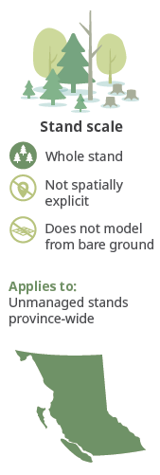
VDYP - Variable Density Yield Prediction
Regional Applicability: Forests of B.C.
Function:
  Used for inventory updates & timber supply
  Best for unharvested, undisturbed stands
  Whole‑stand model
  Short‑ to medium‑term projections
Notes:
Variable Density Yield Prediction (VDYP) VDYP is a provincially supported model widely used for inventory and timber supply. It is empirical and works best for natural stands rather than managed ones.
- whole stand model

Slide 17
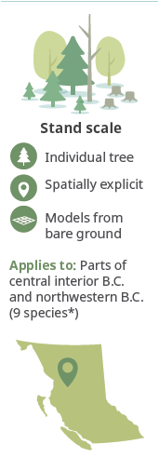
SORTIE-ND
Regional Applicability: parts of SBS and ICH in central and northwest B.C.
  9 species: Sx, Pl, Hw, Cw, Bl, Ba, At, Ep, Act
Function:
  Individual tree model for complex stands
  Well-suited for mixed species interactions & disturbances (natural and complex harvest systems)
  Models inter-tree competition, light, and natural regeneration
Notes:
SORTIE-ND is a Individual- tree model developed to model complex forests with multiple species and size classes of trees.
SORTIE-ND simulates changes in tree populations, individual live and dead trees, and forest floor substrates (including coarse woody debris).
….
It is useful for scientific research and is transitioning to operational use for modelling the effects of pre-commercial and commerical thinning, and for comparing patterns and timing of other partial-harvest prescriptions
SBS and ICH
Neighbourhood dynamics

Slide 18
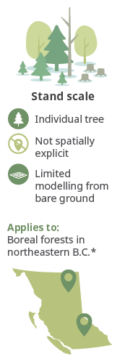
MGM - Mixedwood Growth Model
Regional Applicability: boreal forests in northeastern B.C.
  In 2026 calibration will be complete for southern interior B.C.
  5 species: Sw, At, Pl, Pj, Sb (with more in 2026)
Function:
  Originated as an individual tree model for boreal forests
  Handles mixed species and disturbances
    thinning, understory protection, and some forest health agents
  Includes climate sensitive growth
  Currently being calibrated for forests in the southern interior of B.C.
Notes:
Initially developed to model boreal forests, including aspen spruce mixedwoods, in Alberta and extended to NE B.C.
Mixedwood Growth Model (MGM) models the growth of trees in complex stands, using site-specific calibration data to determine the growth rate of trees and inter-tree competition. While it can handle simple, even-aged stands, it is well-suited to modelling stands containing a mix of species and age classes.

Slide 19
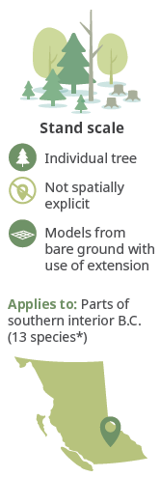
FVS-BC - Forest Vegetation Simulator
previously Prognosis-BC
Regional Applicability: southern interior B.C.
  13 species: Fd, Sx, Pl, Bl, Hw, Cw, Pw, Py, Lw, Bg, Ep, At, Act
Function:
  Individual tree model with broad capabilities
  Models insects, pathogens, fire, climate
  Supports carbon accounting
  Developed in the United States and widely used across N. America
Notes:
FVS was developed in the US and widely used across North America and has been adapted for some of B.C.’s interior forest types. FVS‑BC is highly flexible and can simulate many disturbance types.

Slide 20
Which models will work for you?
What region? Tree species?
  Single species or mixed-species stand
Spatially explicit?
  Silviculture scenarios where spatial pattern matters
    Irregular gap cuts
    Strip cuts oriented east to west vs. north to south
Validated for the question/use scenario
Capability:
  Natural regeneration
  Climate sensitivity
  Evaluate carbon
Notes:
Many models available – unique strengths and applications
Here are some of the items you’ll want to review for each model
Report we’re developing provides more detailed information on the models as well as summary tables that will support model selection

Slide 21
Modeling capability | TASS | TIPSY | VDYP | SORTIE-ND | MGM | FVS-BC
Regional applicability
BEC zones or regions | Across B.C. | Across B.C. | Across B.C. | ICHmc2 and some SBS subzones | Northeastern BC; southern interior in development | IDF, ICH, ESSF, MS, PP and their major subzones
Tree species | Fdc, Fdi, Cw, Hw, Ss, Dr, Sx, At, Pl, Pl/Sx | Fdc, Fdi, Cw, Hw, Ss, Dr, Sx, At, Pl⁴ | All | Sx, Pl, Hw, Cw, Bl, Ba, At, Ep, Act | Sw, At, Pl, Pj, Sb | Fdi, Lw, Bg, Hw, Cw, Pl, Pw, Bl, Ep, At, Act, Sx, Py
Comparison Table
Complex Stands
Limitations:
y
Individual tree model | yes | Individual, tree-based meta-model | - | Yes | yes | yes
Spatially explicit | yes | - | - | yes | - | -
Notes:
Next couple slides provide ex. model comparison tables – excerpts from the model report
Felix Oboite – MGM
MGM - George Harper, Phil Comeau, Richard Kabzems

Slide 22
Modeling capability | TASS | TIPSY | VDYP | SORTIE-ND | MGM | FVS-BC
Useful for…
Bare ground initialization | yes | yes | - | yes | Limited | Limited
Long-term modelling | yes | yes | Limited⁶ | yes | Limited⁷ | Yes
Modelling complex stands
Multiple species | Pl/Sx only (TASS III) | - | Limited | yes | yes | yes
Multi-layer or multi-ages | TASS III only | - | Limited | yes | yes | yes
Complex horizontal arrangements | yes | Limited | - | yes | - | Limited
Broadleaf species and broadleaf/conifer mix | At and Dr, no mixtures | At and Dr, no mixtures | yes | yes | yes | Yes
Natural Regeneration | yes | - | - | yes | - | limited
Notes:
Wildfire risk reduction treatments – understanding how frequently repeat treatments will be required

Slide 23
Modeling capability | TASS | TIPSY | VDYP | SORTIE-ND | MGM | FVS-BC
Disturbances modelled
Clearcut | yes | yes | - | yes | yes | yes
Silviculture treatments | yes | yes | - | yes | Uniformly distributed | Uniformly distributed
Partial harvest systems | yes | - | - | yes | Spatially uniform | Spatially uniform
Commercial thinning | yes | Pure coastal Fd and interior Pl only | - | yes | yes | yes
Insect outbreaks | yes | yes | - | yes | MPB only | yes
Forest disease | yes | yes | - | yes | - | yes
Wildfire | - | Predicts attributes that can be used for predicting wildfire | - | - | - | Yes, but does not predict ignition
Outputs include
Dead trees | yes | yes | - | yes | yes | yes
Timber supply analysis | yes (TIPSY recommended for speed and ease) | yes | yes, for unharvested forests | Can produce yield curves for complex harvests | yes, but limited calibration in BC | yes, but limited calibration and no recent work in B.C.
Carbon accounting | yes | yes | - | yes | Can be derived from biomass | yes
Climate sensitive? | In development | - | - | In development | Yes | yes

Slide 24
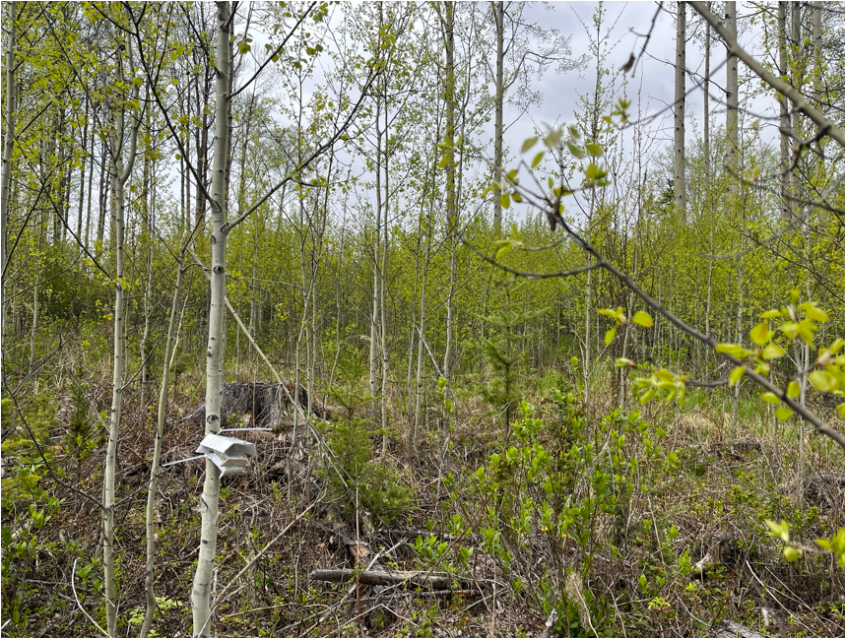
Notes:
Circling back to scenarios at the beginning of the talk

Slide 25
Scenario #1
SBS near Prince George
  Objective: Managing for ungulate habitat
    Desired future condition – a mixed spruce/aspen stand at year 80
      Should I brush this stand?
      How much aspen do I need to retain?
  What model would you use?
    Region, species, spatially explicit?
        MGM or SORTIE
Notes:
In addition to timber values, mgmt. objective of managing for ungulate habitat – desired fut. cond/ is a mixed spruce/aspen stand at year 80
How much aspen do I need to retain?

Slide 26
Additional Scenarios
Explore implications of size and pattern of gap cuts in a mixed ICH in NW BC
  Will support cedar regeneration?
  Spruce regeneration?
      SORTIE-ND
Commercial thinning in SBS pine stand?
      TASS, MGM, SORTIE-ND
Commercial thinning in the southern interior?
      TASS, FVS-BC
Notes:
What model would you use if …

Slide 27
Questions models could be used to address:
Following application of wildfire resilience stocking standards – what future condition will result in 20, 40, 60 years?
  will natural ingress occur?
How do partial harvest patterns compare to clearcuts in sequestering carbon over an 80-year horizon?
Single tree selection – How long until the stand returns to pre-harvest basal area?

Slide 28
Bringing It All Together
Models are powerful tools
No single model fits all situations
Model choice depends on:
  Stand type
  Region and ecosystem
  Management objectives
  Data availability
  Complexity required
Models complement field data and monitoring
Notes:
At end: ->
It is important to emphasize that models are tools—not answers. They support decision‑making but must be used with ecological understanding, good data, and awareness of limitations.

Slide 29
Closing
6 models are available
  TASS, TIPSY, VDYP, SORTIE-ND, MGM, FVS-BC
Strengths and capabilities differ
  important understand what a model is appropriate for
Support move toward innovative silviculture and developing stand development pathways
Report is coming soon
Webinars will follow
Models - continually under development and being updated
    What format of report is most useful to you? (website, printable pdf, published hardcopy)
    Talk to me and let me know!
Notes:
Strengths and capabilities
.…** It is important understand what they’re appropriate for
support innovative silviculture
Moving away from clearcutting – moving towards innovative silviculture – Silv Innov Program – one of the recommendations of the Old Growth Report
New Silv Systems Handbook – emphasis on stand development pathways

Slide 30
Acknowledgements
Model Report Team:
Catherine Bealle Statland, Yanguo Qin, Wenli Xu, Ira Sutherland, Don Robinson, Erica Lilles, Alana Clason, Trevor Blenner-Hassett, Felix Obiote, Caren Dymond
FUSE Consulting Ltd.

Slide 31
Questions and Discussion
For additional information, contact:
Erin Hall RPF, MSc
Forest Science, Planning & Practices Branch, Office of the Chief Forester
Ministry of Forests
Erin.Hall@gov.bc.ca

